Slide 1

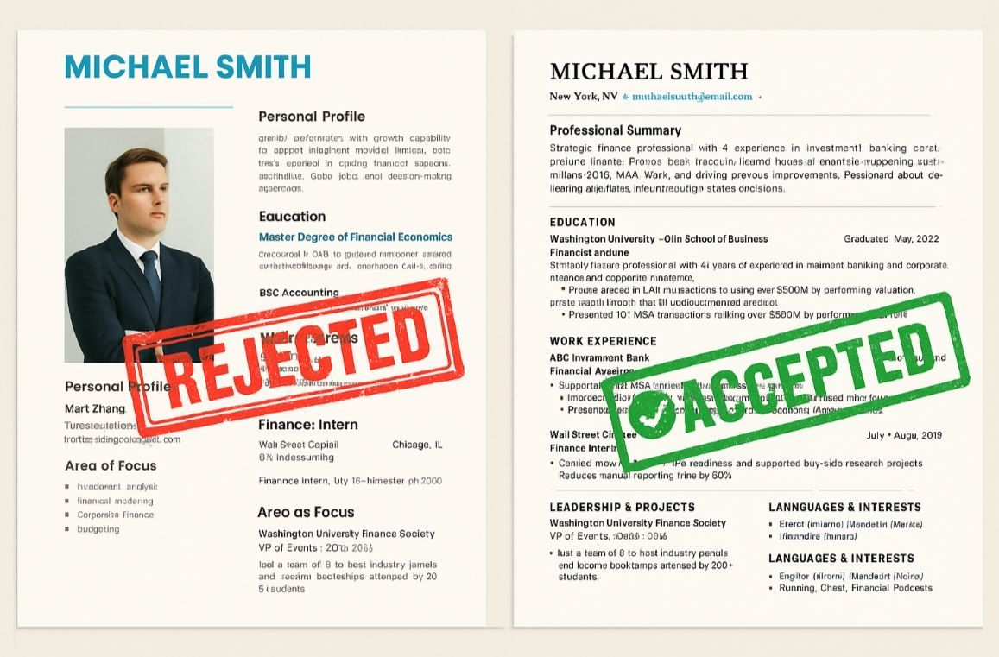
Automated Resume Optimization
AI RESUME ENHANCER
Gemini AI enhancement · Professional templates
Jeevitha M | Nishma Neelamma | Janet Amber Mercy | Anamika Edathatta | Gayatri S

Slide 2



75% of resumes are rejected by ATS filters before a human reads them
Generic resumes fail to match job descriptions
Candidates don't know which keywords or skills are missing
Manual formatting is time-consuming — 2 to 3 hours per application
One-size-fits-all resumes don't work across industries
Problem Statement

Slide 3

Proposed Solution
Extract → Enhance → Export
Upload a resume → get an optimized, ATS-ready PDF back
No external APIs, no cloud dependency — fully offline
Optional: paste a Job Description for targeted tailoring

Slide 4
PDF Upload
↓
Text Extraction (pdfplumber)
↓
Section Detection (Rule-Based NLP)
↓
Domain Classification (Keyword Scoring)
↓
Enhancement Engine (Skills / Experience / Summary)
↓
ATS Score Calculator
↓
Template Renderer (HTML → PDF via wkhtmltopdf)
↓
Edit & Download
System Architecture

Slide 5

professional domains supported: Tech, Law, Finance, Healthcare, Marketing, and more
Domain
Detection System
Each domain has its own: action verbs, hard skills, soft skills, industry terms, role labels
Falls back to "General" profile if no domain strongly matches
This classification drives ALL downstream enhancement decisions

Slide 6
Enhancement Engine
Skills Enhancer
Parses existing skills (comma / pipe / semicolon separated)
If fewer than 6 skills found → supplements from domain skill bank
JD provided? → Prioritises JD-matched skills first
Caps output at 10–12 skills to avoid clutter
Experience Enhancer
Strips weak openers: "responsible for", "assisted with", "helped with"
Replaces with domain-specific power verbs (Law: Represented, Argued; Tech: Architected, Deployed)
Rotates verbs so no two bullets start the same way
Summary Enhancer
Checks if existing summary is meaningful (>80 characters)
If weak or missing → generates a domain-specific template summary
JD provided? → Weaves matching skills into the summary naturally

Slide 7

Section Extraction (NLP)
ATS Score Calculation
Edit Before Download

Slide 8
Resume Templates
TEMPLATE | STYLE | LAYOUT
NOAH | Black & White Bold | Single column, all-caps header
REESE | Minimalist Sidebar | Two-column, dark left panel
OLIVIA | Blue & White Clean | Two-column, tag-based skills

Slide 9
Tech Stack
Layer | Technology
Language | Python
PDF Parsing | pdfplumber
Web Interface | Streamlit
PDF Generation | wkhtmltopdf (HTML → PDF)
NLP | Rule-based (regex + dictionary matching)
Domain Knowledge | Hardcoded dictionaries

Slide 10

Text-based PDFs only — scanned/image PDFs not supported yet
No multi-language resume support currently
Domain detection may misclassify hybrid or niche roles
Enhancement is rule-based, not generative — no novel bullet creation
Limitations

Slide 11

LLM-powered bullet point generation (GPT / local models)
LinkedIn profile import for auto-population
Cover letter generator tailored to the JD
Interview question predictor based on resume gaps
Multi-language support (Hindi, Spanish, French)
Chrome extension for one-click apply + enhance
Future Scope

Slide 12
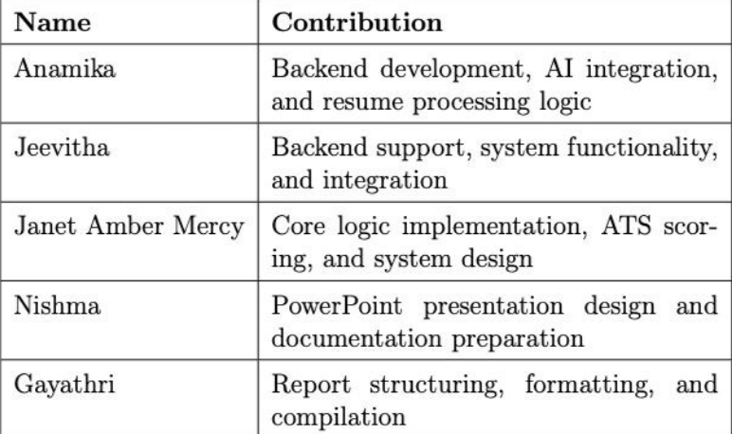

Slide 13
Thank You!
Contact Us

